Slide 1
Key
Event
Receipt
Infrastructure
Ryan W. West
ryan@ryanwwest.com
Notes:
Don’t explain, just go to second slide

Slide 2
Key Management
“Key management refers to management of cryptographic keys in a cryptosystem”
Key generation
Key exchange
Key storage
Key destruction
Key replacement / rotation

Slide 3
Difficulty of Digital Key Management
Digital keys can be stolen remotely, and you may not even know it
Unlike physical locks, digital locks are very hard to pick
Digital keys may protect much greater value than physical keys
If lost or stolen, digital keys can be irreplaceable
Digital keys will become the “keys to your digital life”

Slide 4
Roots-of-Trust (aka Trust Anchors)
All Key Management Systems (KMSs) begin with a root-of-trust
Roots-of-trust form the basis of trust in a system; trust does not need to be derived (depend on another source); it is assumed to be trusted
Examples:
HTTPS/DNS: Root certificates controlled by Let’s Encrypt and other Certificate Authorities
Linux: root account (sudo)
Real life: Government identity systems
Cryptocurrency: Bitcoin’s central ledger/blockchain
Notes:
These form the basis of chains of trust

Slide 5
Types of Roots-of-Trust
Administrative | Algorithmic | Self-certifying
DNS - Certificate Authorities | Blockchains (Bitcoin, Sovrin) | KERI
Assumed trust in the service provider’s reputation | Assumed trust in both cryptography and the reputation of the system (its participants) as a whole | Assumed trust in cryptography alone
Centralized (single point of failure) | Partially Decentralized | Fully Decentralized
Lower security | Higher security | Highest security
Notes:
One reason why algorithmic roots-of-trust may not have as high security as self-certifying ones - if the system and its participants turn malicious, they can still alter past key events (such as a 51% control attack on a blockchain). Self-certifying identifiers as roots of trust do not have this threat.

Slide 6
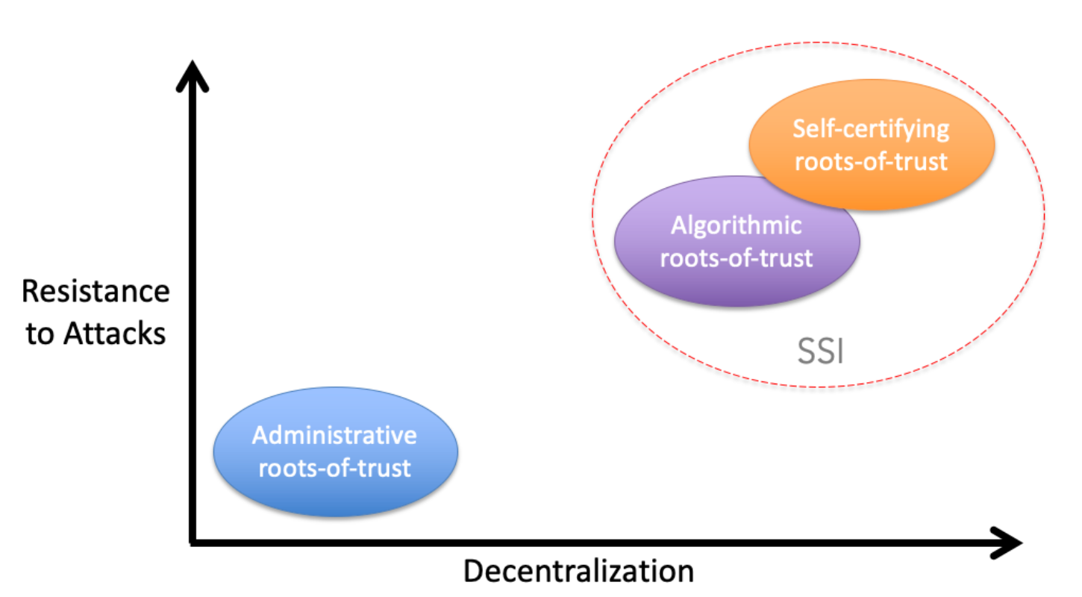
Notes:
Note - delete this before publishing to github

Slide 7
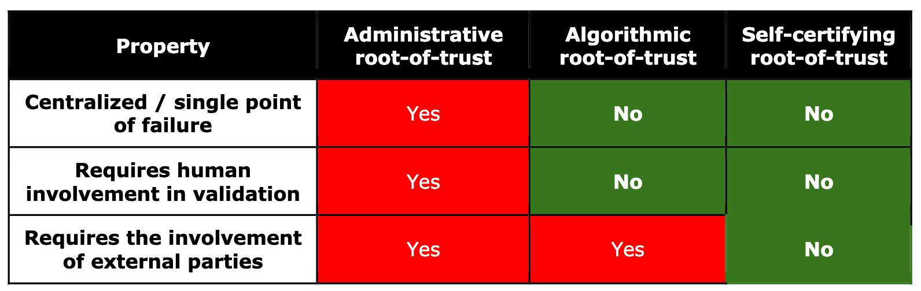

Slide 8
Decentralized Key Management System (DKMS)
Advantages | Challenges
No single point of failure | There cannot be any “higher authority” to fall back on
Interoperability | Must be based on open standards, not one company (or even a consortia)
Portability | Cannot dictate a single ciphersuite
Resilient trust infrastructure | Must be interoperable across different vendors’ technical implementations
Key recovery | Cannot assume specialized knowledge or skills on behalf of end-users
Notes:
Key recovery is built directly into system - no hassle with external authorities

Slide 9


Why Not Use Ledgers?
Ledgers (or blockchains) such as Sovrin or Hyperledger Indy manage public keys and identifiers in a decentralized manner.
Downsides:
Dependency on another party or network
Non-portability (“ledger-lock”)
Potential conflicts with the GDPR “right to be forgotten”

Slide 10
KERI: Key Event Receipt Infrastructure
KERI is a fully decentralized, end-to-end identity system that employs fully cryptographic Self-Certifying Identifiers (SCIDs) as its root-of-trust
Notes:
This is a simplification: some AIDs contain public keys (e.g. non-transferable) but some only contain public key commitments and you need the KEL for the key

Slide 11
KERI: Self-Certifying Identifiers (SCIDs)
SCIDs are derived from public/private key pairs using cryptographic one-way hash functions
The SCID is bound to the key pair; anyone can verify who controls the SCID (aka the controller) with the public key and cryptography alone
No need to rely on an internet connection or any other infrastructure
One can verify the authenticity of messages sent by controller with the SCID
SCIDs are KERI’s roots-of-trust
BXq5YqaL6L48pf0fu7IUhL0JRaU2_RxFP0AL43wYn148
Example AID; typically in Base64
Notes:
This is a simplification: some AIDs contain public keys (e.g. non-transferable) but some only contain public key commitments and you need the KEL for the key

Slide 12
Anatomy of an Self-Certifying Identifier (SCID)
Controller
Publishes
Identifier
Key Event Log (KEL)
Generates
Publishes
Generates
Private Key
Public Key

Slide 13
KERI: Key Event Logs (KELs)
SCIDs are bound to separately-stored key event logs (KELs) for verification even after keys are rotated (updated).
Key rotation, delegation, and revocation can be performed by appending signed events to this log
The most recently rotated key can be retrieved from this log
Always-available witness servers store these KELs for retrieval.
“[KERI] leverages the fact that only the controller of the private key may create and order events that perform verifiable operations on the keys. As long as one complete verifiable copy of the event history is preserved, the provenance of control authority may be established.”
— KERI technical paper

Slide 14
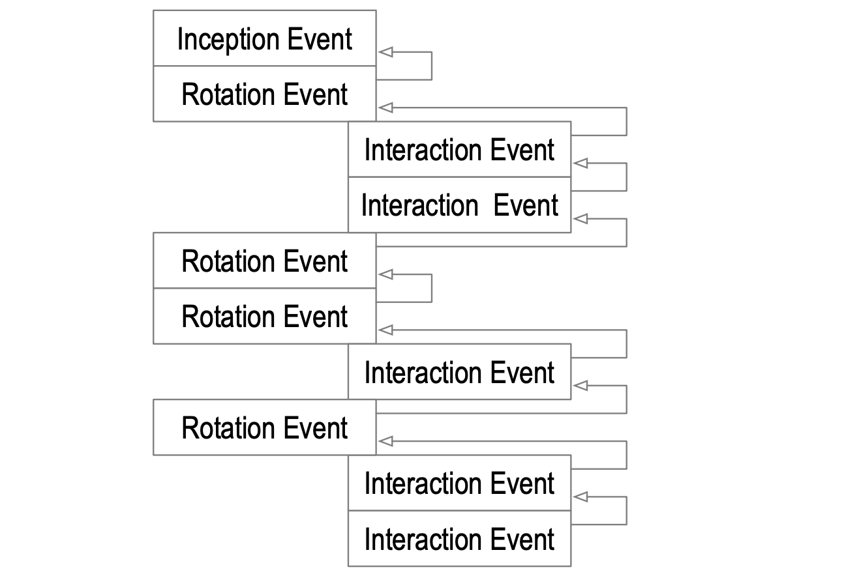
Anatomy of Key Event Log (KEL) and Key Event State (KES)
{
"vs": "KERI10JSON000155_",
"pre": "DvdCuGNS8hfFwsDPr_arwNfcS-XGJjriA_DJFVpvVa98",
"sn": "0",
"ilk": "icp",
"sith": "1",
"keys": [ "DvdCuGNS8hfFwsDPr_arwNfcS-XGJjriA_DJFVpvVa98" ],
"nxt": "E81dOYUE-rI5vSxlXyWWAnrChwJq_XRBndrIGD0YAZ0A",
"toad": "1",
"wits": [ "AA0Qupxej1c7f60oeEqlcWfGheabpg_V9IkEauaZzWuu-R3FNxxc0hyvnG8YyXT2iIV_1lUnw9k8Tqdw76wyNICg"
],
"cnfg": []
}
Produces
Key Event Log (KEL)
Key Event State (KES)

Slide 15
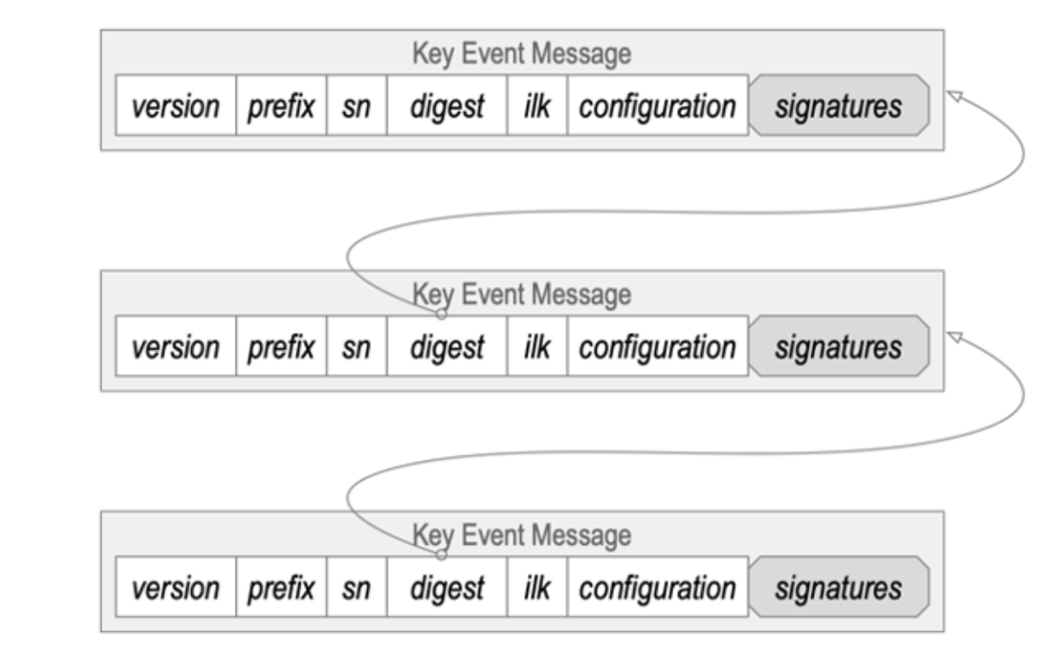
KERI: Key Event Logs (KELs)

Slide 16
KERI: Witnesses
Witness servers store Key Event Logs (KELs) for public retrieval
This enables others to verify the SCID and content signed by its controller/owner
Witnesses are secondary roots-of-trust
They encourage good behavior on behalf of the controller and discourage attackers
Witnesses provide receipts along with each key event for verification
This is where KERI — Key Event Receipt Infrastructure — gets its name
Notes:
“Public” in this sense may only be public to those that the controller shares it with. Witness IP addresses may be shared via Keridemlia, which is a DNS-like routing system for KERI SCIDs (AIDs) and their corresponding witness servers.

Slide 17
KERI: Pre-rotation
In the KEL, the inception event and each key rotation event contain a cryptographic commitment to the next public key
The commitment is a hash digest of the next public key
The next key pair rotation / replacement will be that public key and its private counterpart
Along with a new public key commitment

Slide 18
KERI: Pre-rotation
The only way an attacker can take over the SCID is steal the pre-rotated private key
Very difficult since not even the public key is known (only its digest)
If an attacker compromises the current key pair, they cannot rotate it and have a valid KEL
“But if an attacker compromised an existing private key, could they not immediately publish their own conflicting key event message asserting a new pre-rotated key pair for which the attacker controls the private key? Not if the controller already has one or more witnesses for the controller’s earlier key rotation event message.”

Slide 19
KERI: Additional Benefits
Interoperability - no need to rely on any other infrastructure
You can run all processes and witness servers on your own hardware, or third-party
Delegated SCIDs - enterprises can use interaction key events to create a hierarchy of revocable SCIDs bound to key-pairs for horizontal scalability
“The ability of KERI to provide universally portable, interoperable, and verifiable SCIDs and key event logs means the KERI protocol can enable a trust spanning layer for the Internet the same way the Internet Protocol (IP) created a data spanning layer for the Internet”
One day, KERI’s SCIDs could replace DNS for domain identifier -> IP address mappings
Notes:
3a. This is in the works and is called Keridemlia.

Slide 20
Credits
This presentation covers significant portions of Dr. Sam Smith’s chapter manuscript on Decentralized Key Management for an upcoming book on Self-Sovereign Identity. Many quotes have been taken directly from the text. The pre-publication is available here: https://github.com/SmithSamuelM/Papers/blob/master/whitepapers/10-ssi-key-management.pdf

